Slide 1
Generic Steps of Datapath
rd
PC
instruction
memory
registers
rs
Data
memory
rt
ALU
+4
imm
2. Decode/
Register
Read
1. Instruction
Fetch
5. Register
Write
3. Execute
4. Memory
Notes:
missing: multiplexors or “data selectors” – where should they be in this picture and why?
also missing – opcode for control of what operations to perform
state elements vs combinational ones – combinational given the same input will always produce the same output – out depends only on the current input

Slide 2
Datapath Walkthroughs (1/3)
add $r3,$r1,$r2 # r3 = r1+r2
Stage 1: fetch this instruction, increment PC
Stage 2: decode to determine it is an add, then read registers $r1 and $r2
Stage 3: add the two values retrieved in Stage 2
Stage 4: idle (nothing to write to memory)
Stage 5: write result of Stage 3 into register $r3

Slide 3
Example: add Instruction
reg[1]+ reg[2]
reg[1]
3
PC
instruction
memory
registers
1
Data
memory
reg[2]
ALU
2
+4
imm
add r3, r1, r2

Slide 4
Datapath Walkthroughs (2/3)
slti $r3,$r1,17 # if (r1 <17 )r3 = 1 else r3 = 0
Stage 1: fetch this instruction, increment PC
Stage 2: decode to determine it is an slti, then read register $r1
Stage 3: compare value retrieved in Stage 2 with the integer 17
Stage 4: idle
Stage 5: write the result of Stage 3 (1 if reg source was less than signed immediate, 0 otherwise) into register $r3

Slide 5
Example: slti Instruction
reg[1] <17?
reg[1]
x
instruction
memory
registers
PC
1
Data
memory
ALU
3
+4
imm
17
slti r3, r1, 17

Slide 6
Datapath Walkthroughs (3/3)
sw $r3,17($r1) # Mem[r1+17]=r3
Stage 1: fetch this instruction, increment PC
Stage 2: decode to determine it is a sw, then read registers $r1 and $r3
Stage 3: add 17 to value in register $r1 (retrieved in Stage 2) to compute address
Stage 4: write value in register $r3 (retrieved in Stage 2) into memory address computed in Stage 3
Stage 5: idle (nothing to write into a register)

Slide 7
Example: sw Instruction
reg[1] +17
reg[1]
x
instruction
memory
registers
PC
1
Data
memory
reg[3]
ALU
3
+4
imm
17
SW r3, 17(r1)
MEM[r1+17]<=r3

Slide 8
Why Five Stages? (1/2)
Could we have a different number of stages?
Yes, and other architectures do
So why does MIPS have five if instructions tend to idle for at least one stage?
Five stages are the union of all the operations needed by all the instructions.
One instruction uses all five stages: the load

Slide 9
Why Five Stages? (2/2)
lw $r3,17($r1) # r3=Mem[r1+17]
Stage 1: fetch this instruction, increment PC
Stage 2: decode to determine it is a lw, then read register $r1
Stage 3: add 17 to value in register $r1 (retrieved in Stage 2)
Stage 4: read value from memory address computed in Stage 3
Stage 5: write value read in Stage 4 into register $r3

Slide 10
Example: lw Instruction
reg[1] +17
reg[1]
x
instruction
memory
PC
1
registers
Data
memory
ALU
3
imm
MEM[r1+17]
+4
17
LW r3, 17(r1)

Slide 11
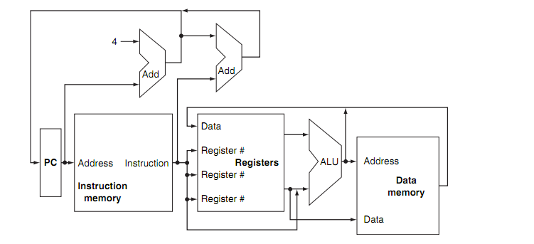
Peer Instruction Multiplexer usage
How many places in this diagram will need a multiplexor to select one from multiple inputs?
a) 0 b) 1 c) 2 d) 3 e) 4 or more

Slide 12
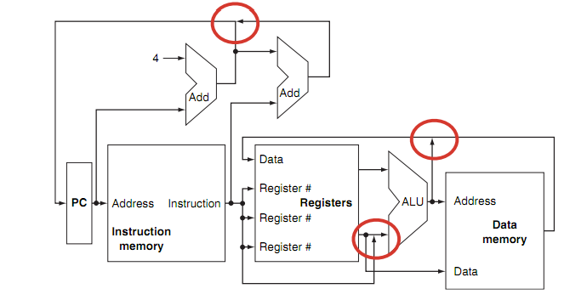
Peer Instruction Multiplexer usage
How many places in this diagram will need a multiplexor to select one from multiple inputs
a) 0 b) 1 c) 2 d) 3 e) 4 or more

Slide 13
Datapath and Control
Datapath based on data transfers required to perform instructions
Controller causes the right transfers to happen
rd
PC
instruction
memory
registers
rs
Data
memory
rt
ALU
+4
imm
opcode, funct
Controller

Slide 14
Why a Single-Cycle Implementation Is Not Used Today
Although the single-cycle design will work correctly, it would not be used in modern designs because it is inefficient.
The clock cycle must have the same length for every instruction in this single-cycle design.
The clock cycle is determined by the longest possible path in the processor. This path is almost certainly a load instruction, which uses five functional units in series:
the instruction memory,
the register file,
the ALU,
the data memory,
the register file.
The overall performance of a single-cycle implementation is likely to be poor, since the clock cycle is too long.

Slide 15
CPU Clocking (2/2)
Alternative multiple-cycle CPU: only one stage of instruction per clock cycle
Clock is made as long as the slowest stage
Several significant advantages over single cycle execution: Unused stages in a particular instruction can be skipped OR instructions can be pipelined (overlapped)
2. Decode/
Register
Read
1. Instruction
Fetch
3. Execute
4. Memory
5. Register
Write

Slide 16
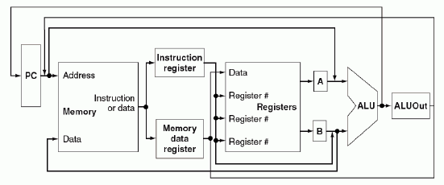
A Multicycle implementation
Allows a functional unit to be used more than once per instruction, as long as it is used on different clock cycles
This sharing can help reduce the amount of hardware required.
A single memory unit is used for both instructions and data.
There is a single ALU, rather than an ALU and two adders.
One or more registers are added after every major functional unit to hold the output of that unit until the value is used in a subsequent clock cycle.

Slide 17
Pipeline
In next section, we’ll look at another implementation technique, called pipelining,
that uses a datapath very similar to the single-cycle datapath but is much more efficient by having a much higher throughput.
Pipelining improves efficiency by executing multiple instructions simultaneously.

